Slide 1



UNIT 8:
Fit and healthy
Andy’s week

Slide 2
Where were you yesterday at 4.30 in the afternoon?
Where were you on Sunday evening?
Where were you last Saturday morning?

Slide 3
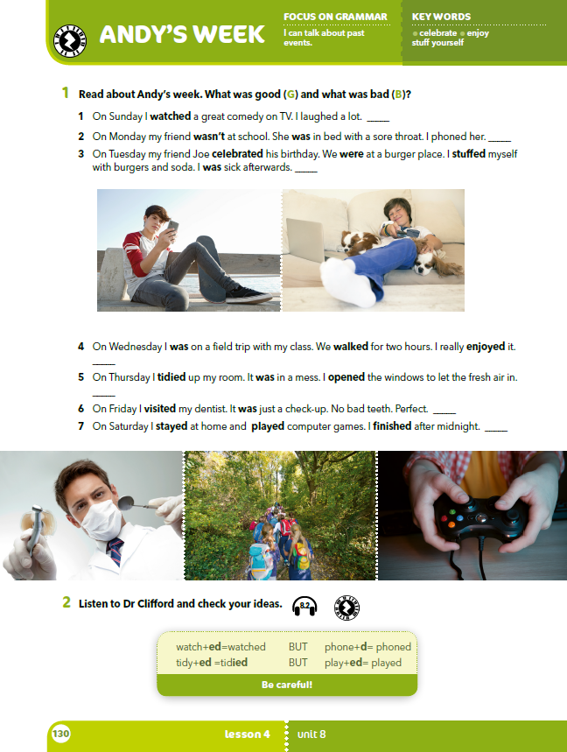
Look at the boy’s week.
Where was he?
Who was he with?
Which of these actions were good for his health?
Which were bad for his health?

Slide 4
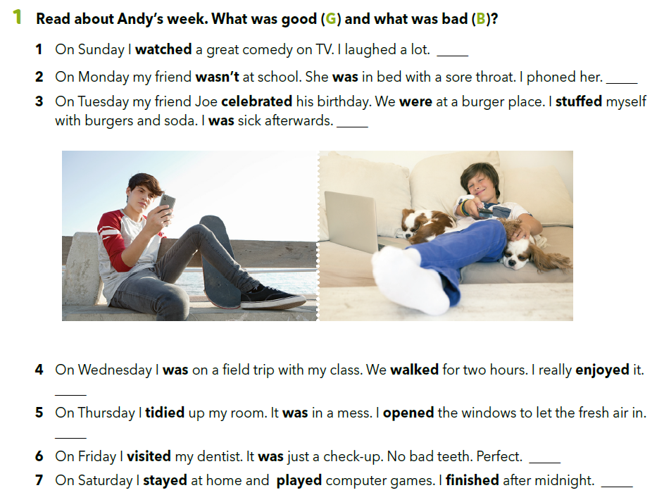


G
G
B
https://www.e-sfera.hr/dodatni-digitalni-sadrzaji/4c3cd197-6f47-499b-8510-fa81e51a252a/assets/audio/60_dr_clifford.mp3
G
G
G
B

Slide 5
G
Look at the words in bold.
What do they have in common?
They finish in –d or –ed.
G
B
G
G
G
B

Slide 6
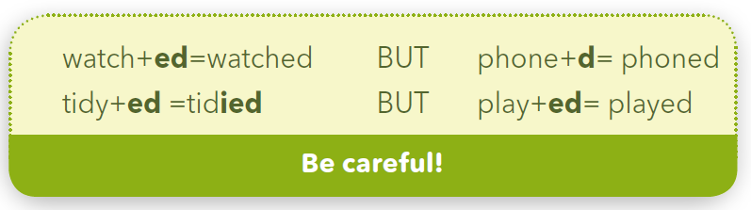
U prošlom glagolskom vremenu „past simple” na glagol dodajemo nastavak –d ili –ed.
celebrate → phone →
watch → open →
Kad glagol završava na –y, a prije njega se nalazi samoglasnik, glagolu dodajemo nastavak „–ed".
play → stay →
Kad glagol završava na –y, a prije njega se nalazi suglasnik, „y” mijenjamo u „i” i dodajemo nastavak –ed.
cry → tidy →
celebrated
phoned
watched
opened
played
stayed
cr + i + ed → cried
tid + i + ed → tidied

Slide 7
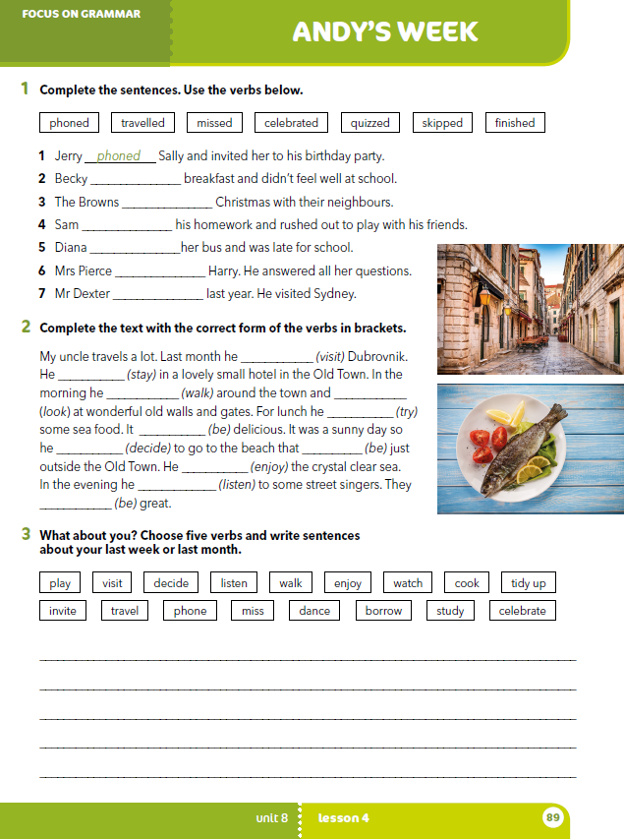
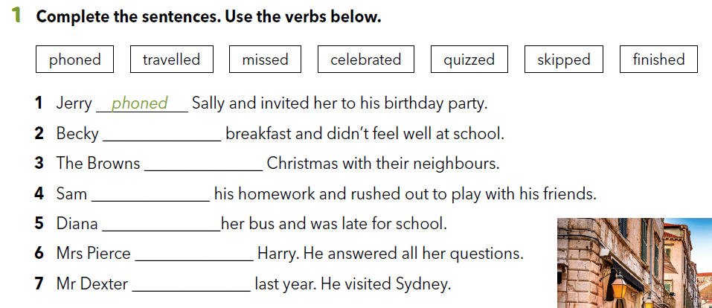
Workbook p 89.
skipped
celebrated
finished
missed
quizzed
travelled

Slide 8
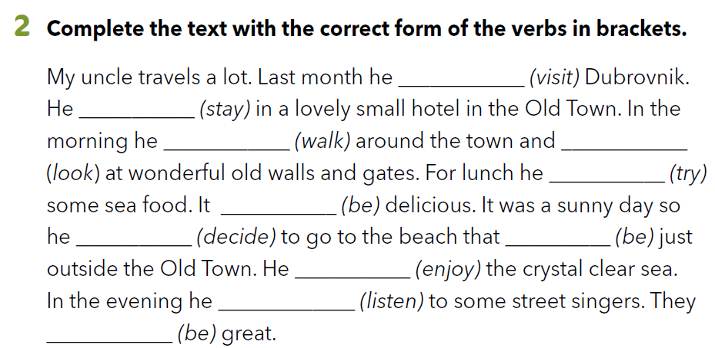
visited
stayed
walked
looked
tried
was
decided
was
enjoyed
listened
were

Slide 9
G
G
You have 1 minute to read the text again. Try to remember as much information as possible.
Close your book. What was Andy’s week like?
B
Write three sentences about your last week. Use at least three different verbs from the text about Andy.
G
G
G
B

Slide 10
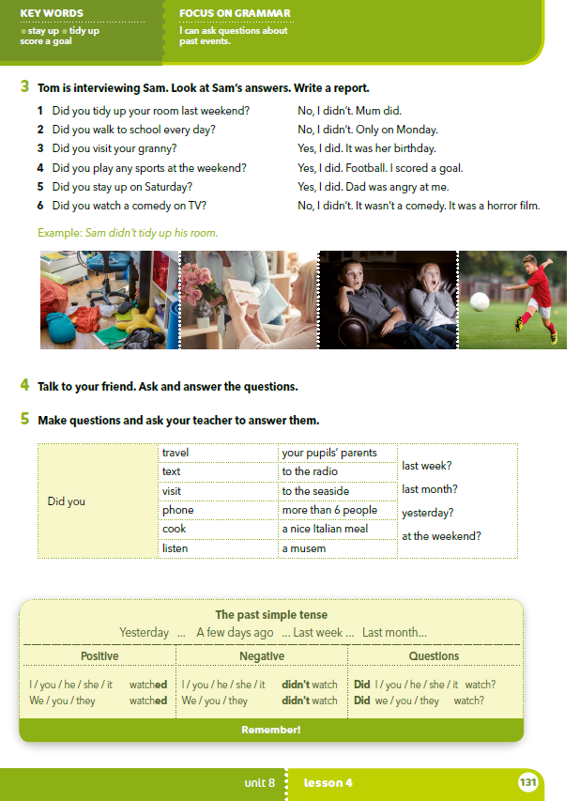
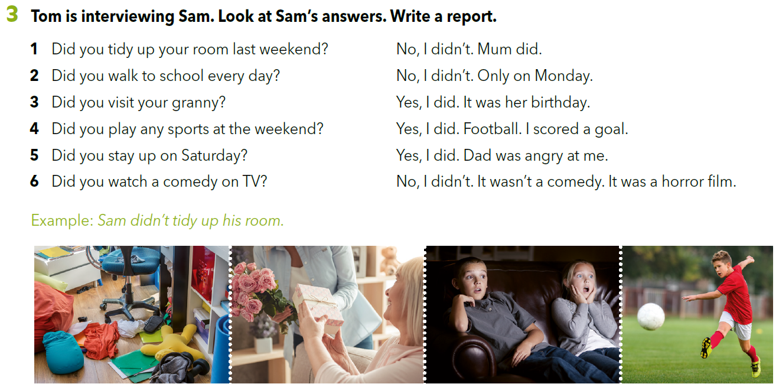

Slide 11
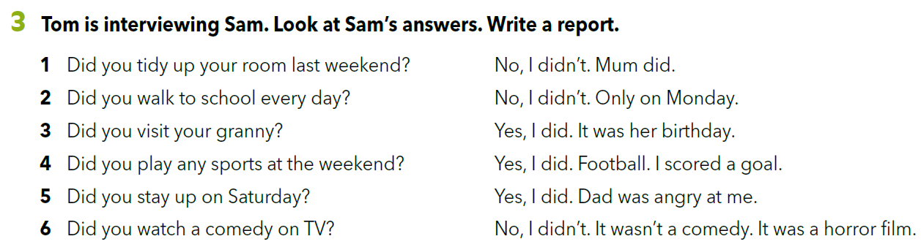

Slide 12
PAST SIMPLE QUESTIONS
You watched a good film yesterday.
Did you watch a good film yesterday?
Did + subject + verb in the infinitive (without the suffix –d or –ed)

Slide 14
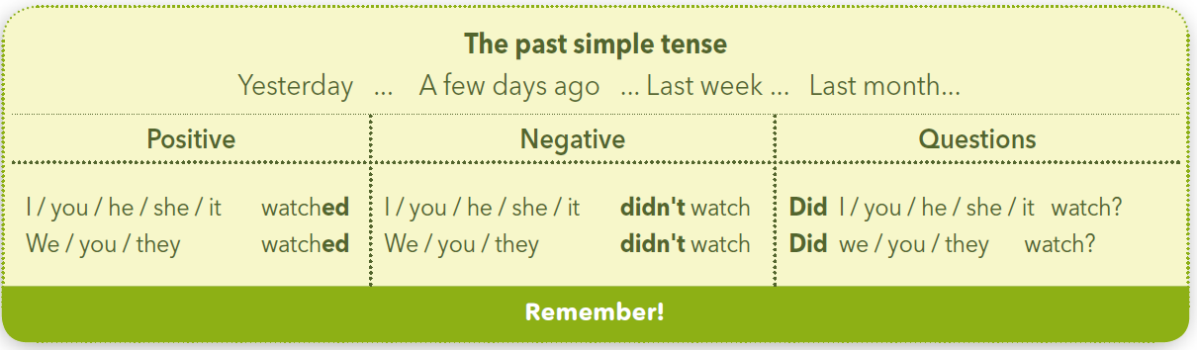
You watched a good film yesterday.
You did not (didn’t) watch a good film yesterday.
PAST SIMPLE NEGATIVE SENTENCES
subject + did not (didn’t) + verb in the infinitive
Glagolsko vrijeme „past simple” koristimo uz izraze:
yesterday
a few days ago
last week
last month

Slide 15


Slide 16
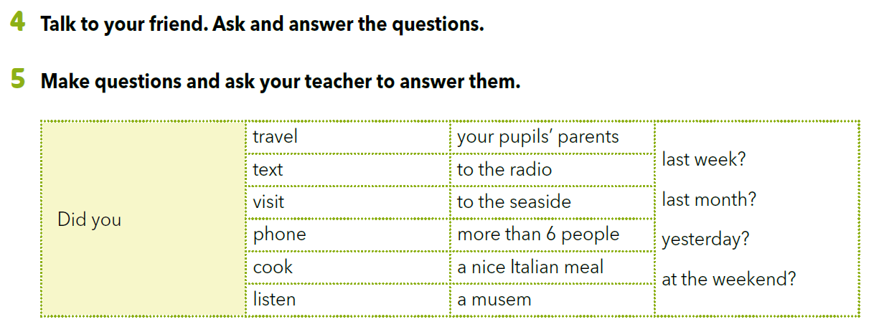

Slide 17
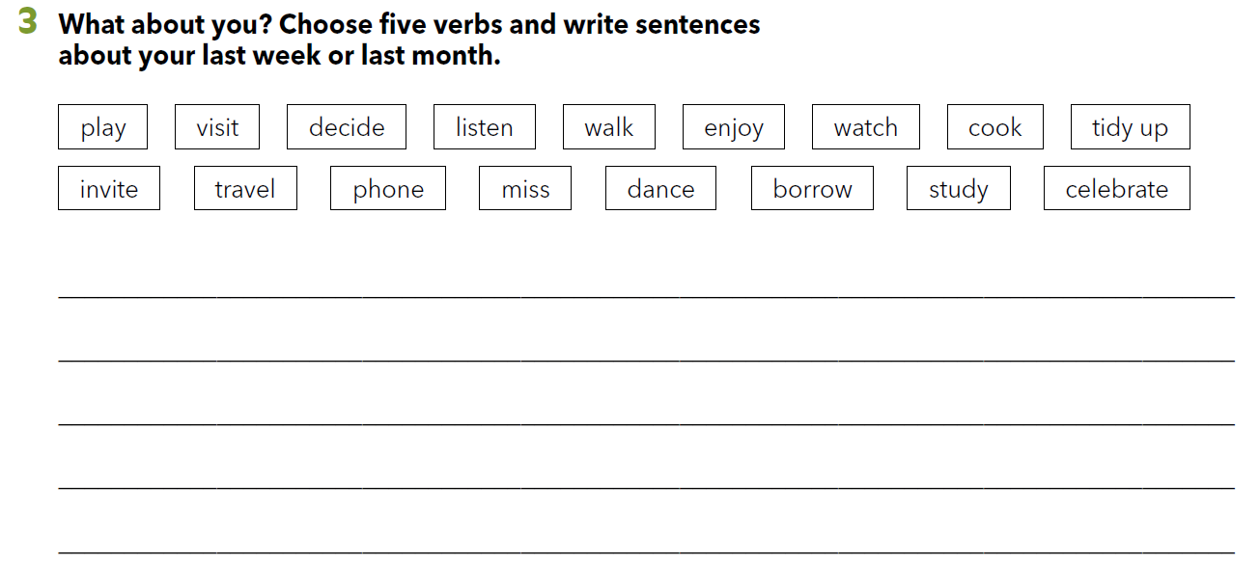
Workbook p. 89

Slide 18

LET’S REVISE!
PLAY AND LEARN.
https://www.e-sfera.hr/dodatni-digitalni-sadrzaji/4c3cd197-6f47-499b-8510-fa81e51a252a/
SELF CHECK
https://www.e-sfera.hr/dodatni-digitalni-sadrzaji/4c3cd197-6f47-499b-8510-fa81e51a252a/

Slide 19
LEARN MORE
https://www.e-sfera.hr/dodatni-digitalni-sadrzaji/4c3cd197-6f47-499b-8510-fa81e51a252a/
Antonio’s week

